Slide 1

Microsoft 365 Overview
Mr. Salin Kumar. C.S
Sr. Pre-Sales Consultant – MS Cloud
Redington Middle-East and Africa

Slide 2
Microsoft Cloud
Global Trusted Hybrid

Slide 3
Introduction to Office 365
Office 365 is a suite of services offered by Microsoft.
Office 365 is the same Office you already know and use every day, but with a slightly different interface and many more features.
Office 365 is powered by the cloud, so you can access your applications and files from virtually anywhere (desktops, tablets, mobile phones), and they're always up to date.

Slide 4
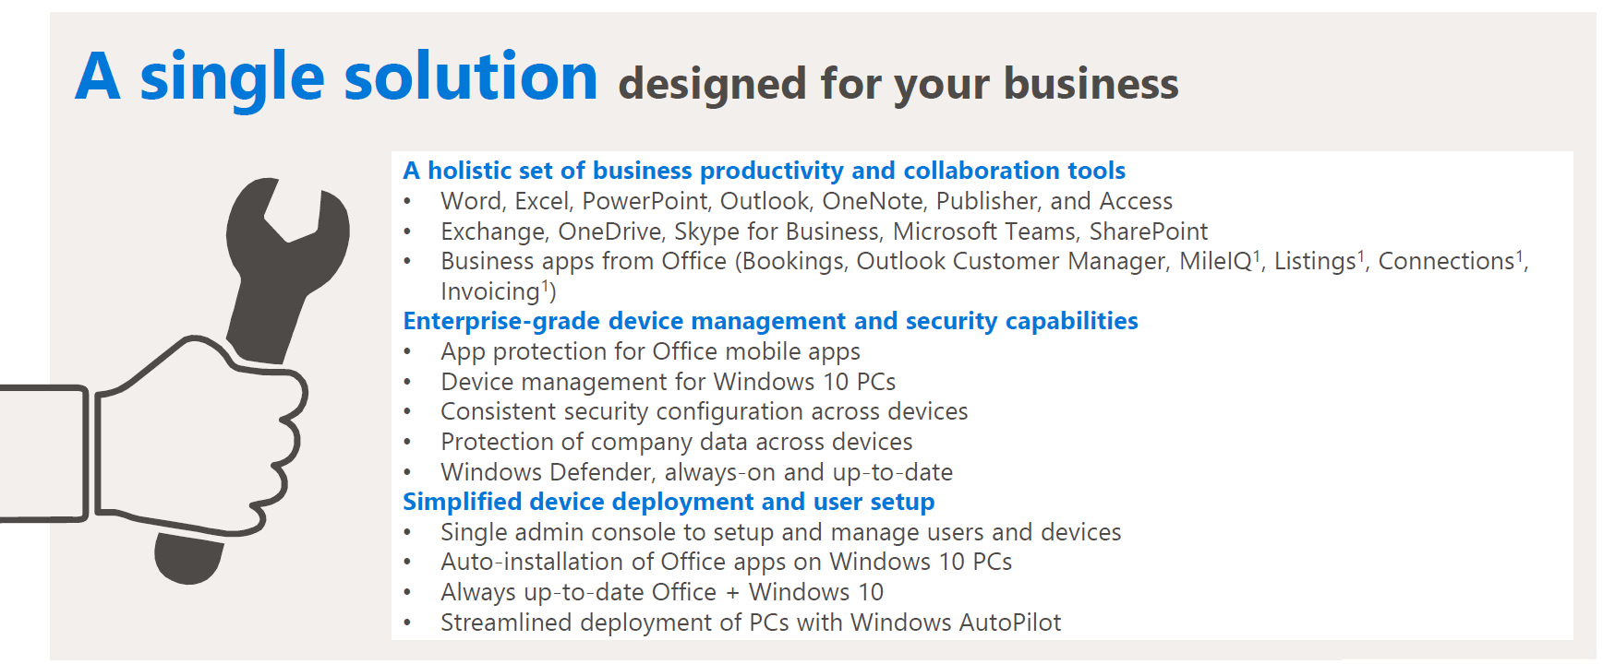
Introduction to Microsoft 365
An integrated solution bringing together best-in-class productivity tools, security and device management

Slide 5

Cloud: Efficiency Versus Control
Microsoft Cloud
= Managed for You | Standalone Servers | IaaS | PaaS | SaaS
Applications
Runtimes
Database
Operating System
Virtualization
Server
Storage
Networking
Efficiency
Control+Cost

Slide 6
Cloud Terminology
Infrastructure as a Service (IaaS): basic compute and storage resources
On-demand servers
Amazon EC2, VMWare vCloud
Platform as a Service (PaaS): cloud application infrastructure
On-demand application-hosting environment
E.g. Google AppEngine, Salesforce.com, Windows Azure
Software as a Service (SaaS): cloud applications
On-demand applications
E.g. Office 365, Microsoft 365, GMail, Microsoft Office Web Companions

Slide 7

Azure services everywhere
55 Azure regions
1000s of service providers
1,0000s of enterprises

Slide 8


Slide 9
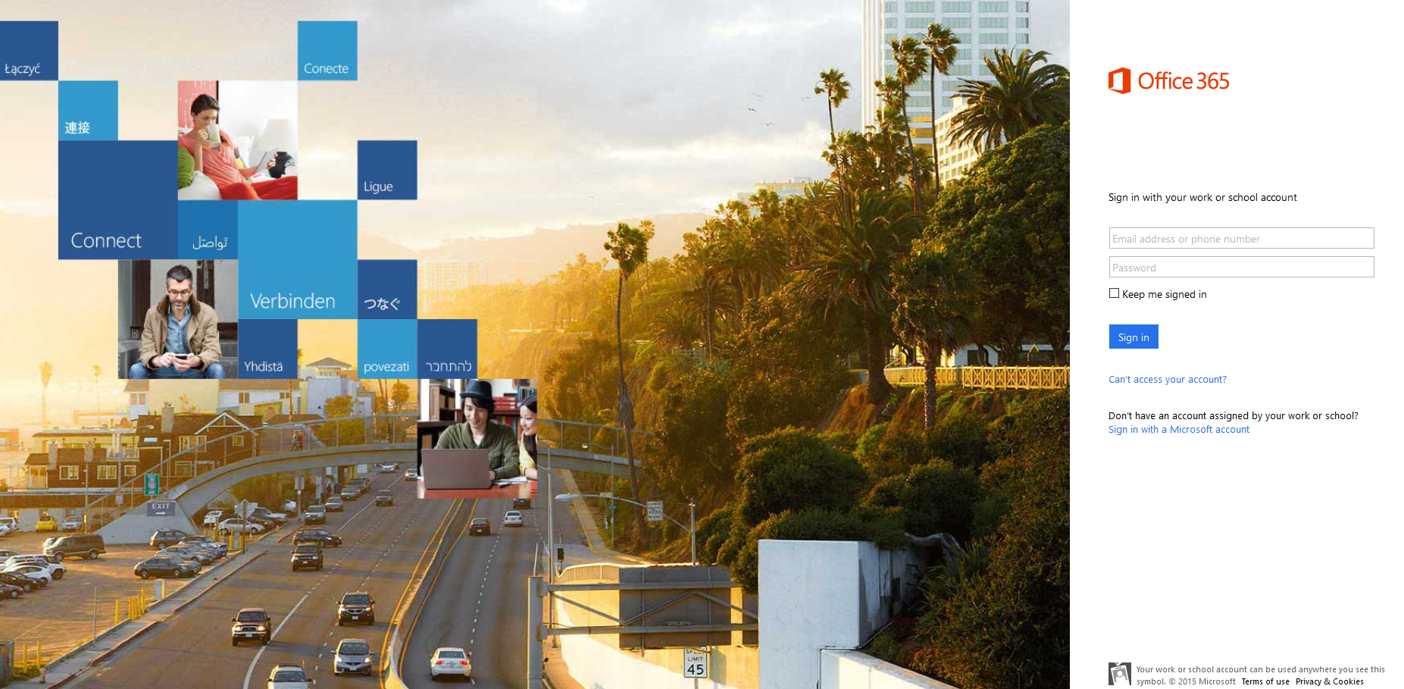
Log in to Microsoft 365
Open your browser and go to https://login.microsoftonline.com(portal.office.com)

Slide 10
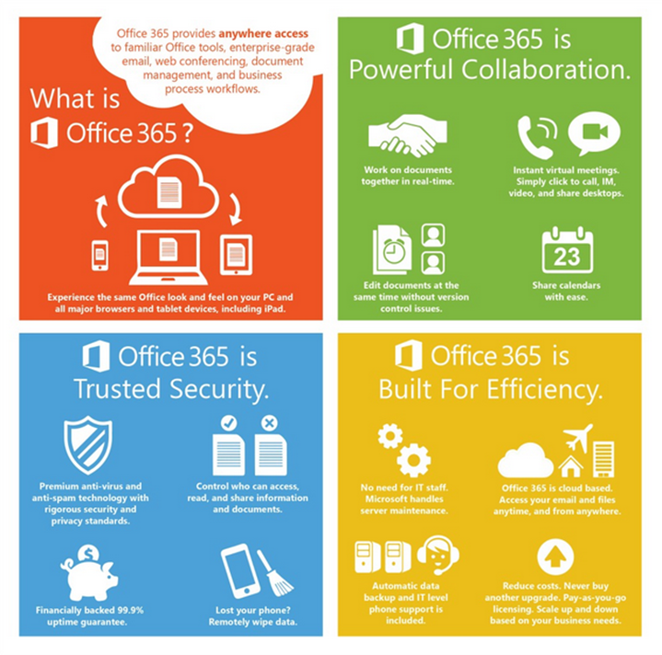
Why use Office 365?
Office 365 let’s you use your suite of Office apps on any device in any location.
It allows you to communicate and collaborate with people in your organisation and beyond.
It is a secure environment facilitated by Microsoft.
As a Cloud based service it diminishes the need for on-site infrastructure and engineer support. It is managed locally through web based management console so you can customise it.

Slide 11
Office 2016 vs Office 365:What’s the difference?
Office 2016
One time purchase and includes the following:
Word, PowerPoint, Excel, Access, Publisher and Outlook
You have to purchase a new version
Office 365
Is a subscription service includes the following:
Word, PowerPoint, Excel, Access, Publisher, Outlook, OneDrive, OneNote, SharePoint, Teams and Skype for Business
Automatically receive the latest version

Slide 12
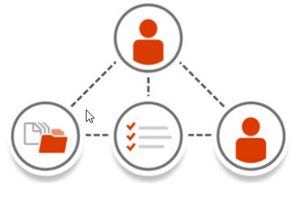
Microsoft 365 : Built for Teamwork

Slide 13
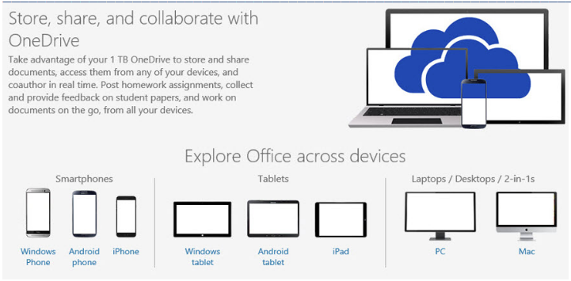
Microsoft 365 : Collaborate with Office Online

Slide 14
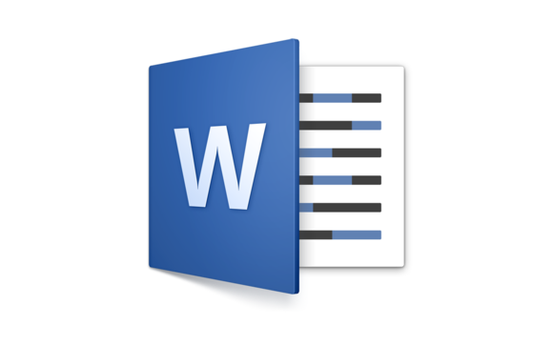
Office Suite: Word 365

Slide 15
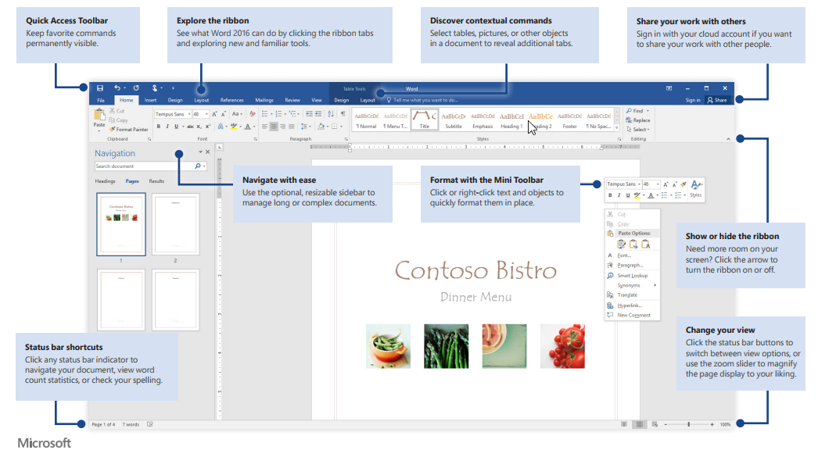
Office Suite: Word 365

Slide 16
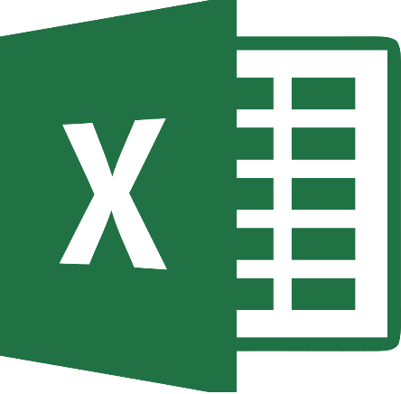
Office Suite: Excel 365

Slide 17
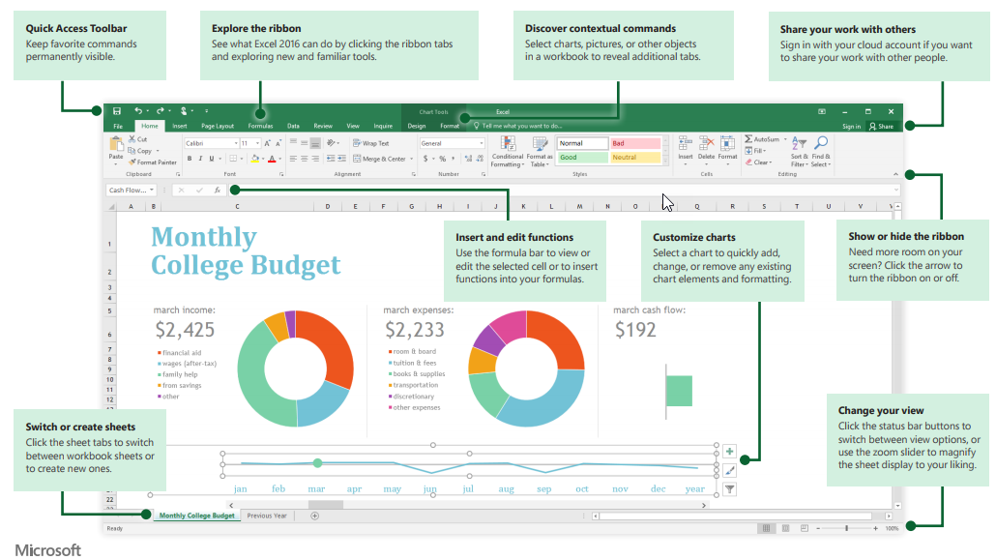
Office Suite: Excel 365

Slide 18

Office Suite: PowerPoint 365

Slide 19
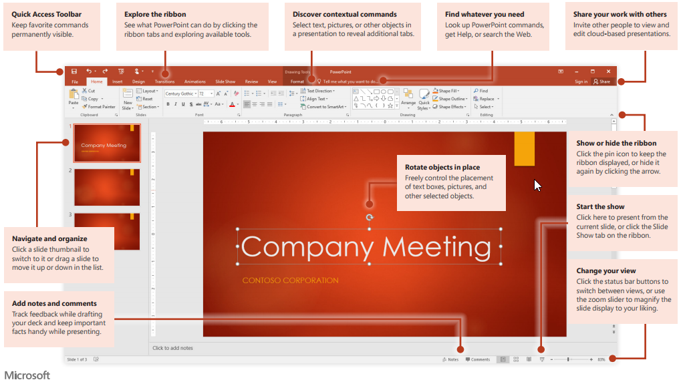
Office Suite: PowerPoint 365

Slide 20

Office Suite: Outlook 365

Slide 21
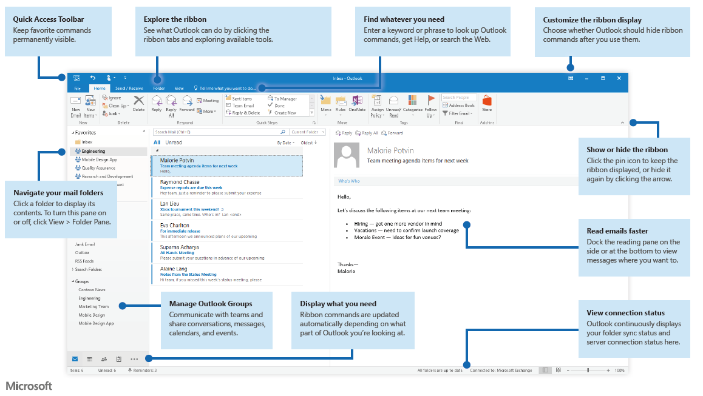
Office Suite: Outlook 365

Slide 22
Outlook Web App
The Outlook Web App (OWA) allows you to check and manage your Outlook from your Web browser, whether you’re inside or outside of the office.
Any changes you make in your OWA will be synced to your Outlook application, and vice versa.
To access your OWA, visit https://outlook.office365.com and log in using your credentials.

Slide 23

Microsoft 365 : OneDrive for Business

Slide 24
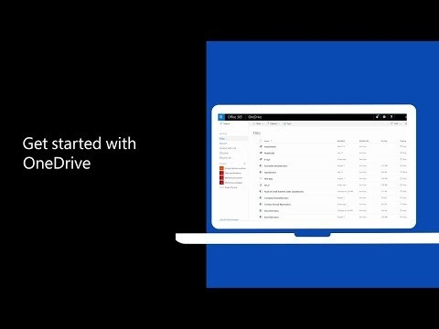
Microsoft 365 : OneDrive for Business
Integral part of Office 365
Provides a place in the cloud where you can store, share and sync your work files
Update and share your files from any device with OneDrive
Notes:
.

Slide 25
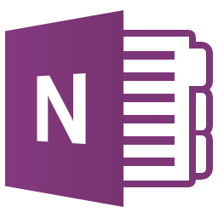
Microsoft 365 : OneNote

Slide 26
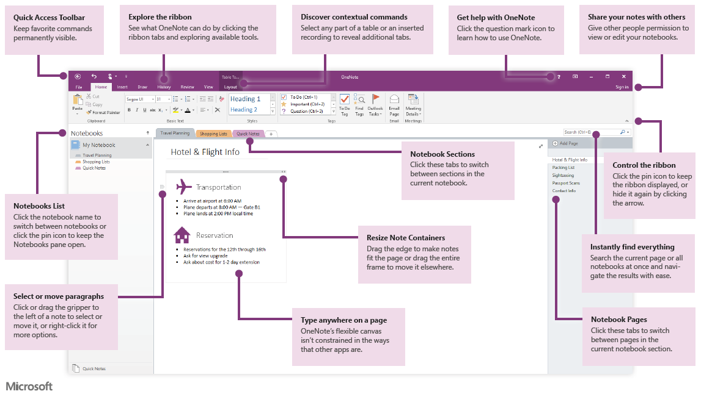
Microsoft 365 : OneNote

Slide 27
Microsoft 365 : Office Online
Office Online is an online office suite offered by Microsoft, which allows users to create and edit files using lightweight Microsoft Office web apps: Word, Excel, PowerPoint and OneNote. The offering also includes Outlook.com, People, Calendar and OneDrive, all of which are accessible from a unified app switcher.

Slide 28

Microsoft 365 : SharePoint Online

Slide 29
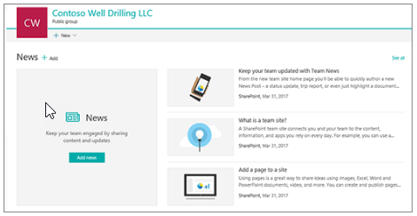
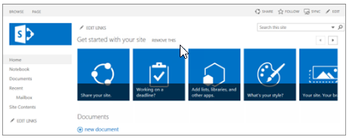
Microsoft 365 : SharePoint
SharePoint Online
SharePoint Server

Slide 30
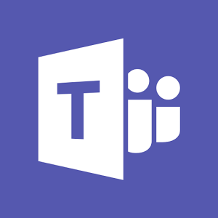
Microsoft 365 : Teams

Slide 31
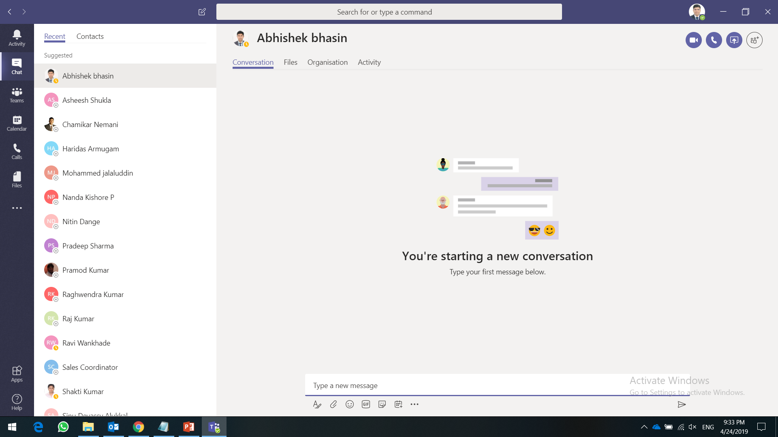
Microsoft 365 : Teams

Slide 32
Exchange Online
Exchange Online is a hosted messaging solution that delivers the capabilities of Microsoft Exchange Server as a cloud-based service. It gives users access to email, calendar, contacts, and tasks from PCs, the web, and mobile devices.

Slide 33
Exchange Online Archive
Exchange Online Archiving offers users advanced archiving capabilities with the archive mailbox feature. An archive mailbox is a specialized mailbox that appears alongside the users' primary mailbox folders in Outlook or Outlook Web App. ... In addition, they can search both their archives and primary mailboxes

Slide 34
Microsoft 365 Advanced Threat Protection
Office 365 Advanced Threat Protection (ATP) safeguards your organization against malicious threats posed by email messages, links (URLs) and collaboration tools.
ATP includes:
Threat protection policies: Define threat-protection policies to set the appropriate level of protection for your organization.
Reports: View real-time reports to monitor ATP performance in your organization.
Threat investigation and response capabilities: Use leading-edge tools to investigate, understand, simulate, and prevent threats.
Automated investigation and response capabilities: Save time and effort investigating and mitigating threats.

Slide 35
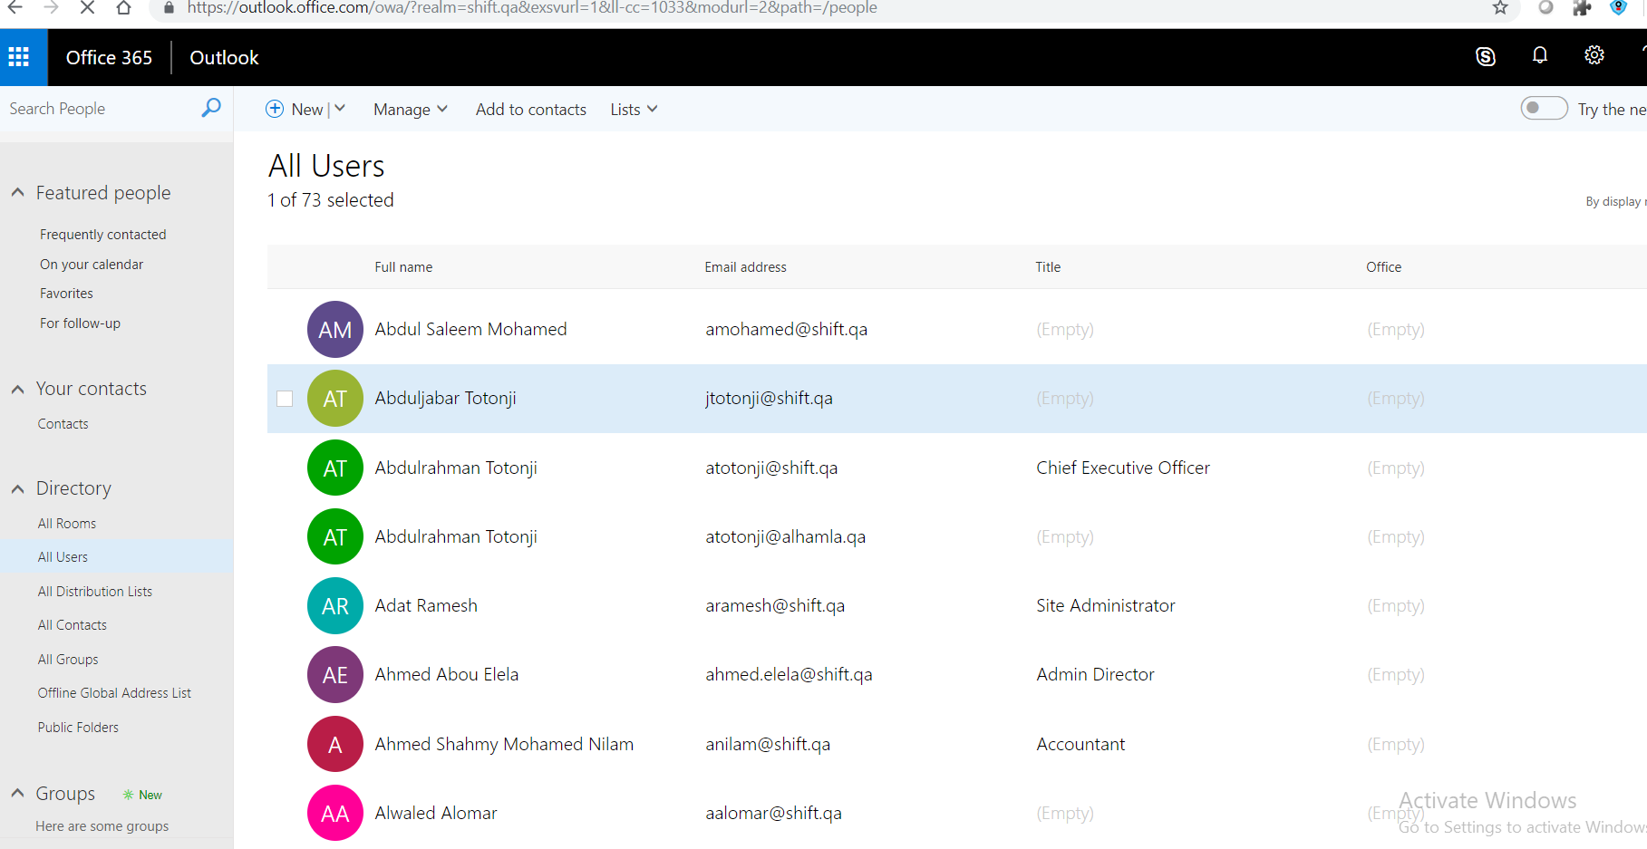
People in Microsoft 365
People is where your personal contacts are stored and where you can view any address books that have been set up for your organization. People is a way that Outlook on the web can help you get to the most important messages first.

Slide 36
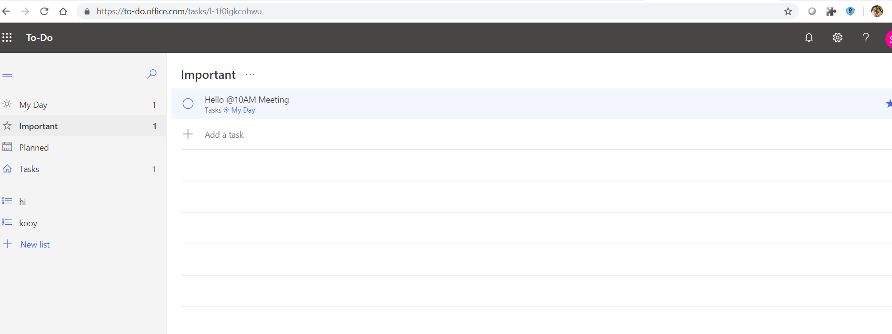
Microsoft To-Do
From work to play, To-Do is the easiest way to get stuff done, every day.

Slide 37
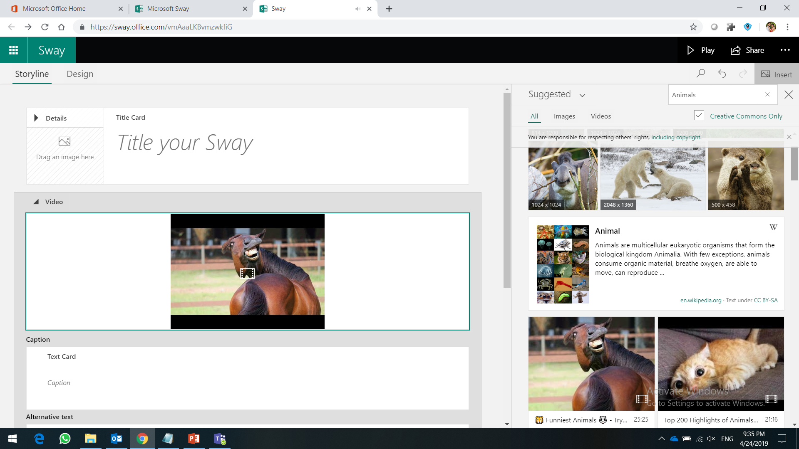
Microsoft 365 : Sway
Office Sway is a presentation program and is part of the Microsoft Office family of products. Sway is designed for conveying concepts quickly, easily and clearly.

Slide 38
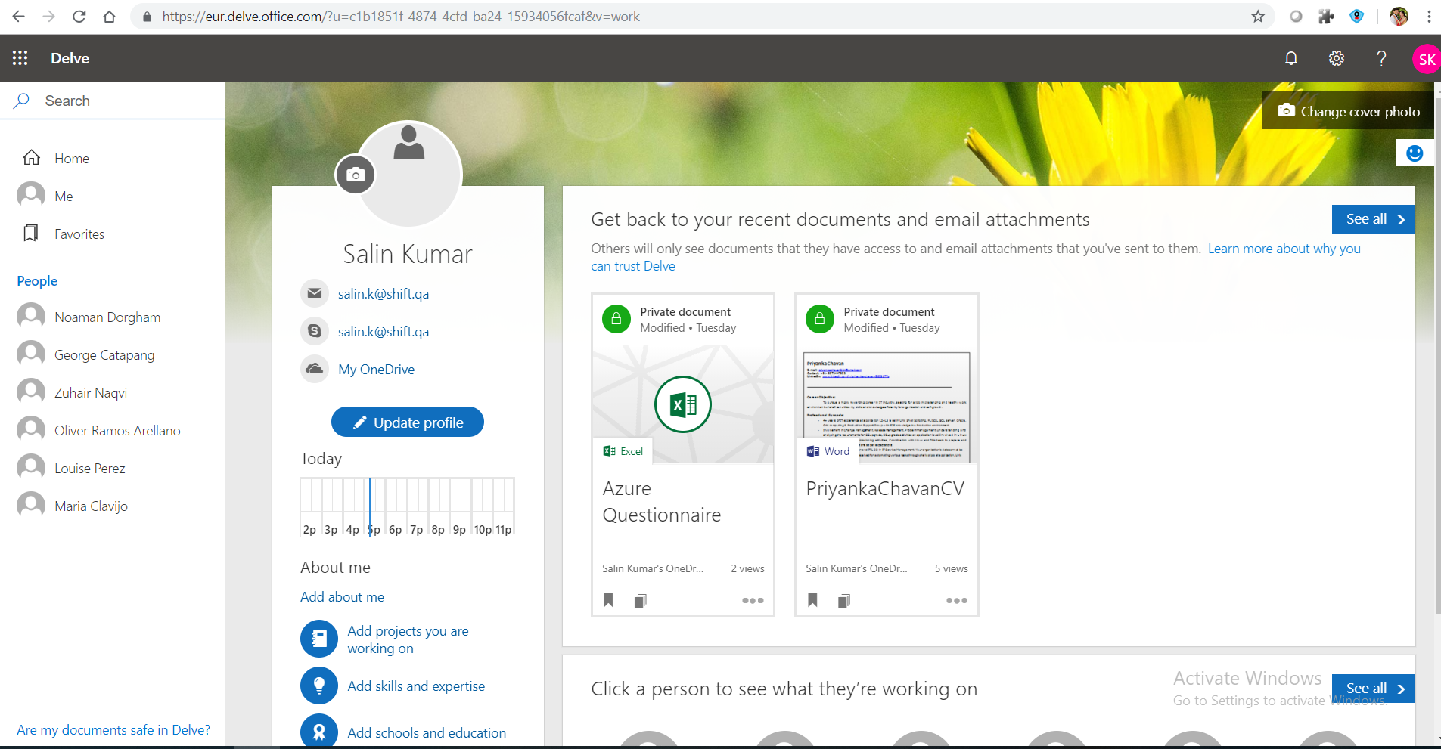
Microsoft 365 : Delve
Use Delve to manage your Office 365 profile, and to discover and organize the information that's likely to be most interesting to you right now - across Office 365. Delve never changes any permissions, so you'll only see documents that you already have access to.

Slide 39
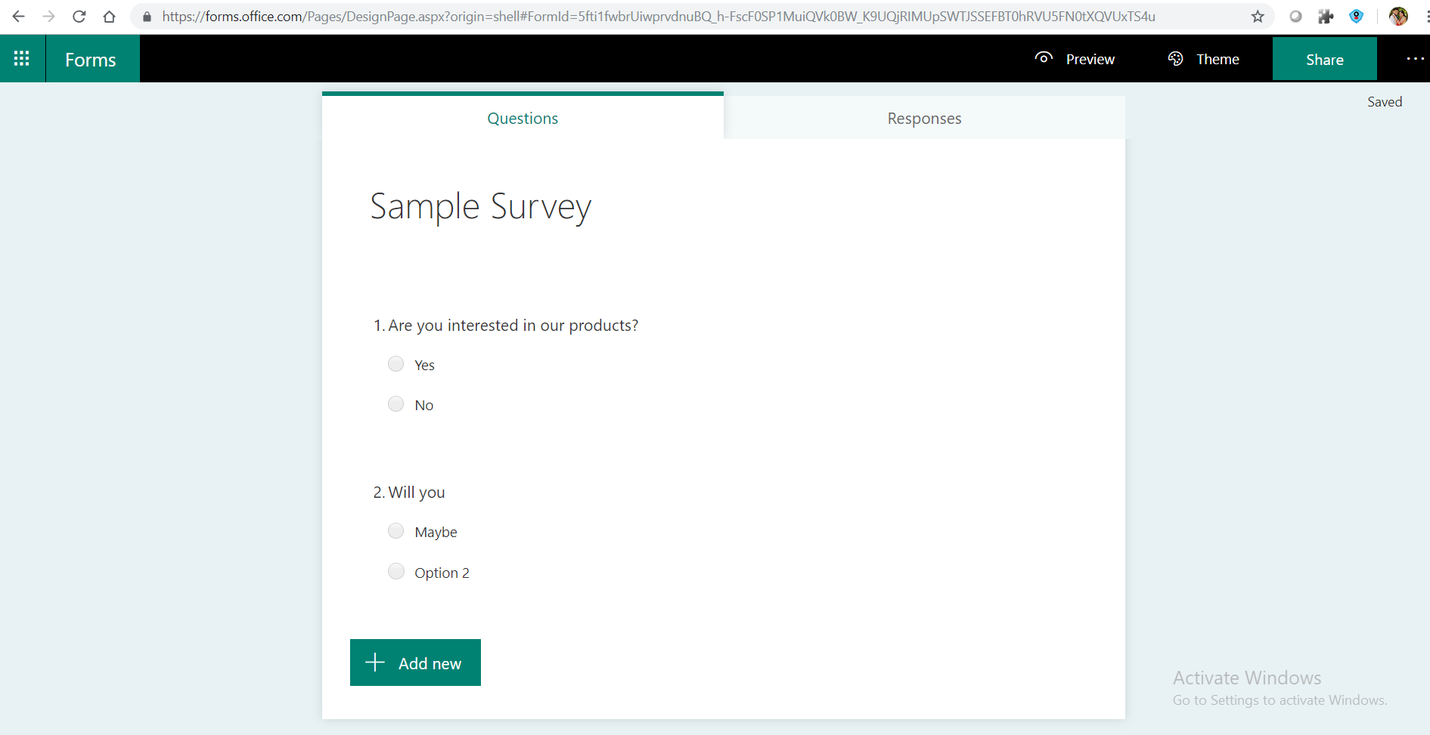
Microsoft 365 : Microsoft Forms
Microsoft Forms is an online survey creator, part of Office 365. Microsoft Forms is a simple, lightweight tool that lets you quickly create a form, collect responses in real time, and view automatic charts to visualize your data.

Slide 40
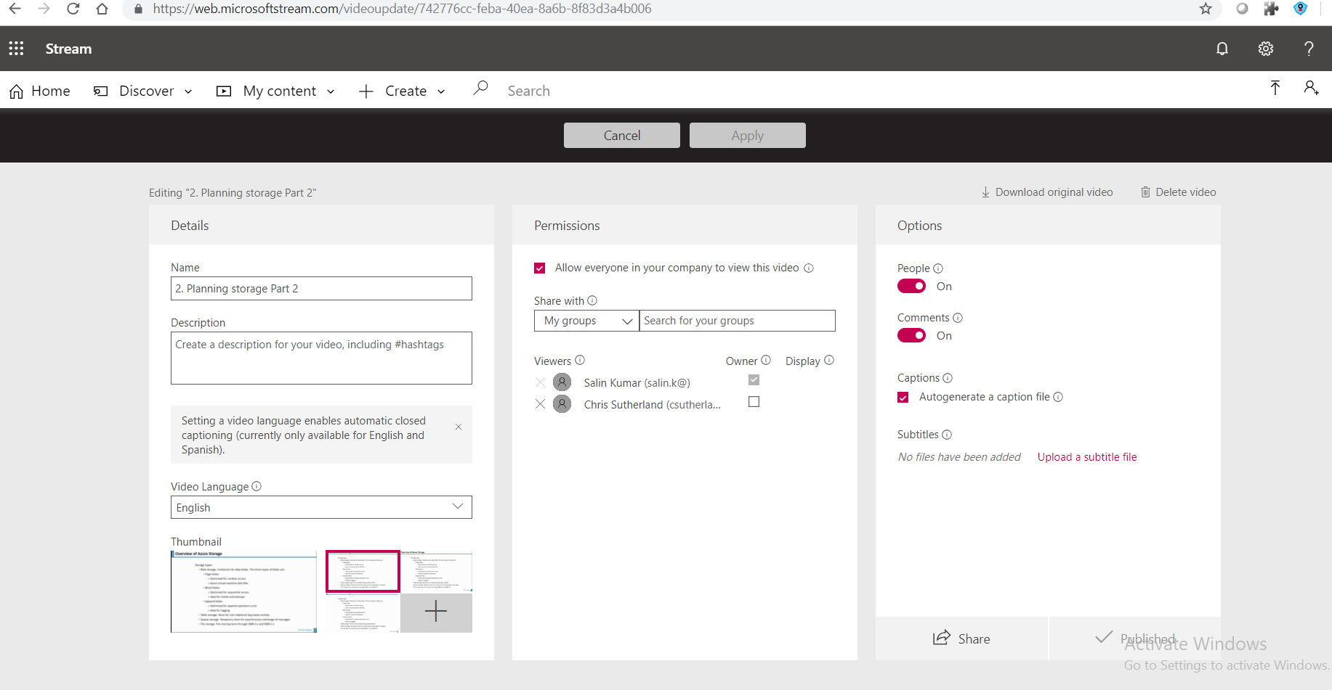
Microsoft 365 : Microsoft Stream
Microsoft Stream is an Enterprise Video service where people in your organization can upload, view, and share videos securely. Microsoft Stream also makes it easy to share comments on a video, tag timecodes in comments and descriptions to refer to specific points in a video and discuss with colleagues.

Slide 41
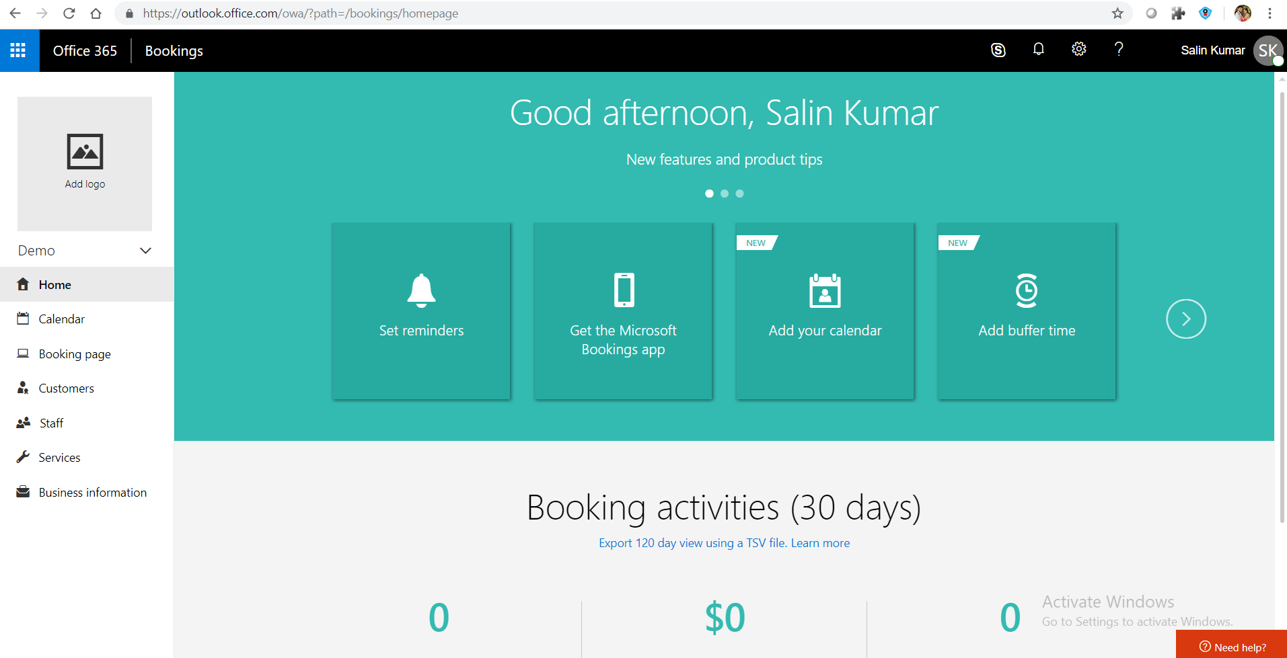
Microsoft 365 : Microsoft Bookings
Microsoft Bookings brings online appointment scheduling to your customers, and brings booking software to any size business.

Slide 42
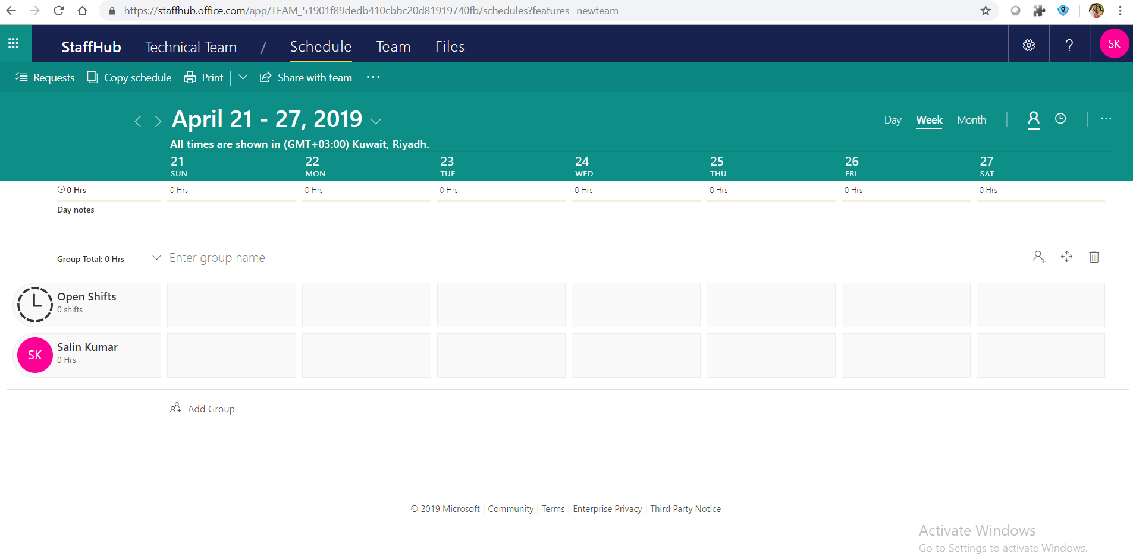
Microsoft 365 : Microsoft Staff hubs
Microsoft StaffHub makes it easy for managers to create, update and manage shift schedules for their team, streamlining what has been a labour-intensive process.
Employees have access to all their shift information, including the ability to easily swap shifts with others right from the Microsoft StaffHub web/mobile app.

Slide 43
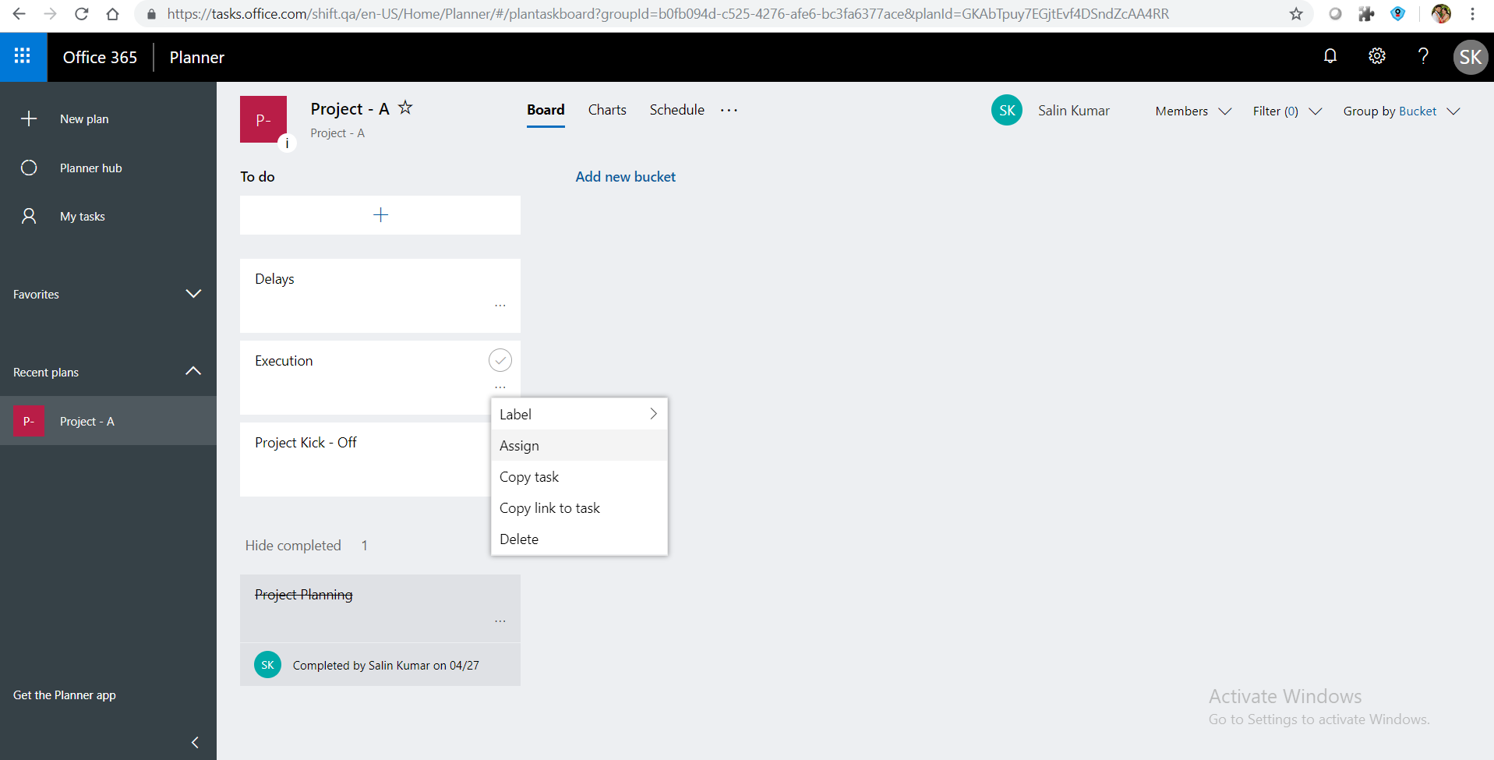
Microsoft 365 : Microsoft Planner
Microsoft Planner is mainly used for Project Management.

Slide 44
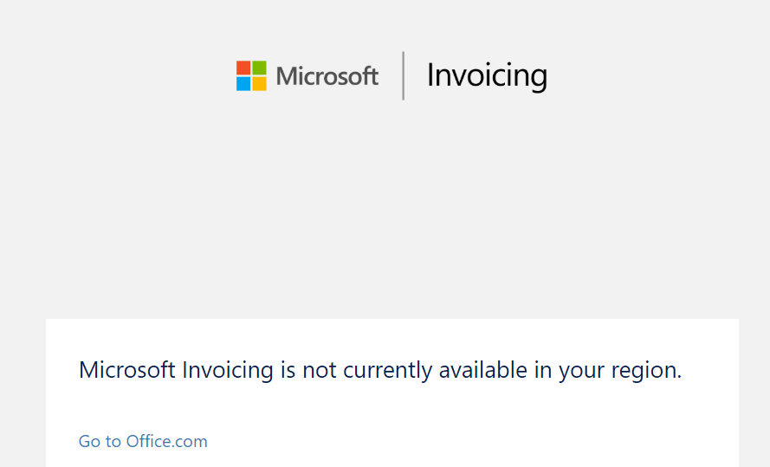
Microsoft 365 : Microsoft Invoicing
Microsoft Invoicing is an online and mobile invoicing solution available as part of Microsoft Office 365 Business Premium subscriptions. Users can create and send PDF format invoices to customers, accept payments through PayPal, sync data with QuickBooks Online, track sales, and more

Slide 45
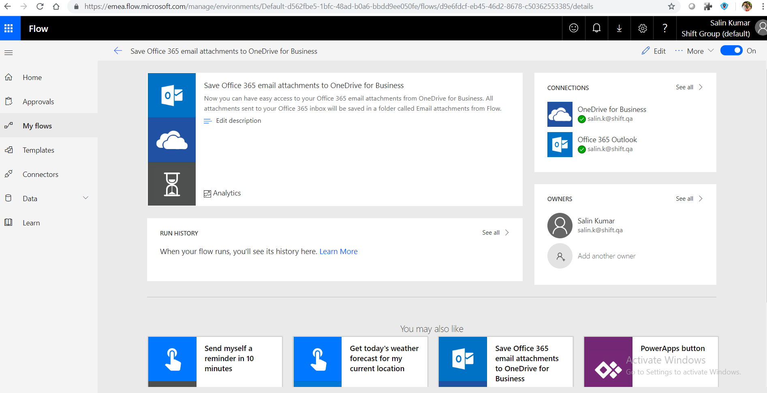
Microsoft 365 : Microsoft Flow
Microsoft Flow is cloud-based software that allows employees to create and automate workflows and tasks across multiple applications and services without help from developers. Automated workflows are called flows. To create a flow, the user specifies what action should take place when a specific event occurs.

Slide 46
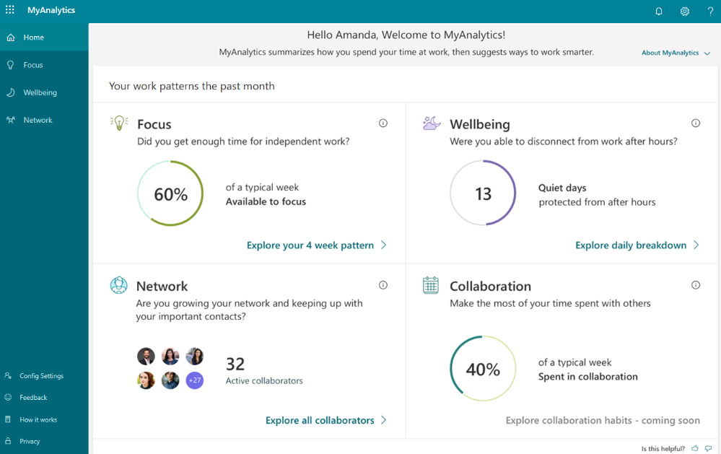
Microsoft 365 : Microsoft MyAnalytics
MyAnalytics provides insights into two of the key factors in personal productivity: how people spend their time and who they spend it with. You and your team can get these benefits after an administrator sets up MyAnalytics within your organization.

Slide 47
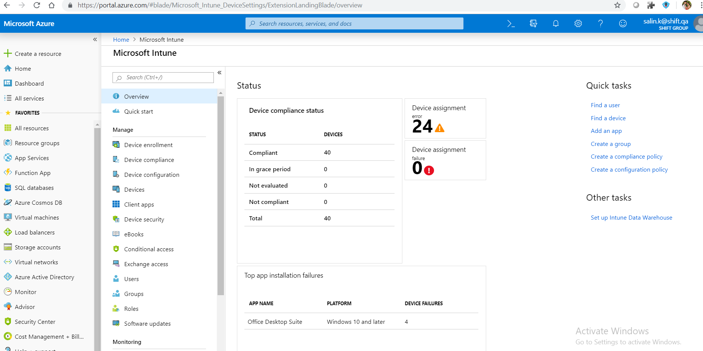
Microsoft 365 : Microsoft Intune
Microsoft Intune is a Microsoft cloud-based management solution that provides for mobile device and operating system management. It aims to provide Unified Endpoint Management of both corporate and BYOD devices in a way that protects corporate data.

Slide 48
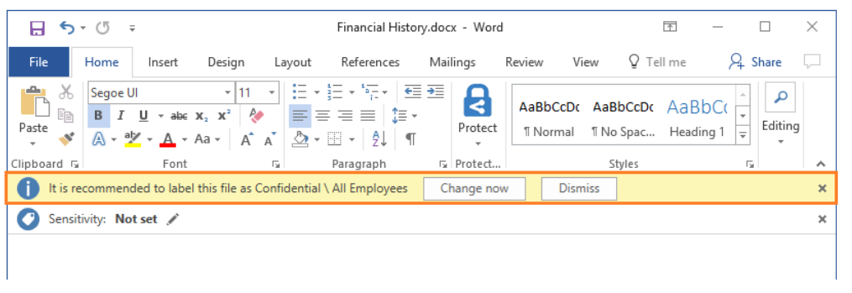
Microsoft 365 : Azure Information Protection
Azure Information Protection (AIP) is a cloud-based solution that helps an organization to classify and optionally, protect its documents and emails by applying labels. Labels can be applied automatically by administrators who define rules and conditions, manually by users, or a combination where users are given recommendations.

Slide 49
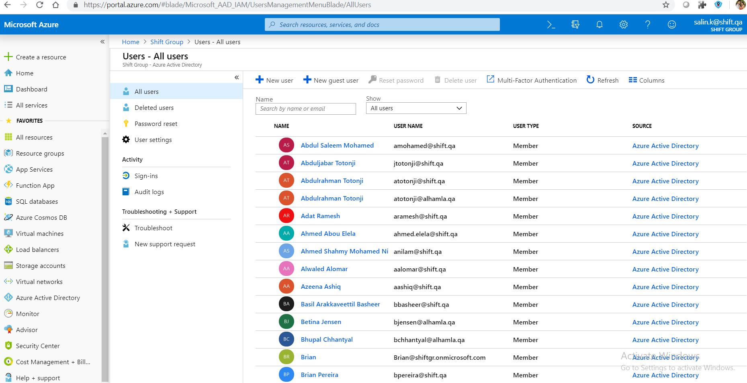
Microsoft 365 : Azure Active Directory Premium
Azure Active Directory (Azure AD) is Microsoft's cloud-based identity and access management service. Azure AD helps your employees sign in and access resources in: ... Internal resources, such as apps on your corporate network and intranet, along with any cloud apps developed by your own organization.

Slide 50
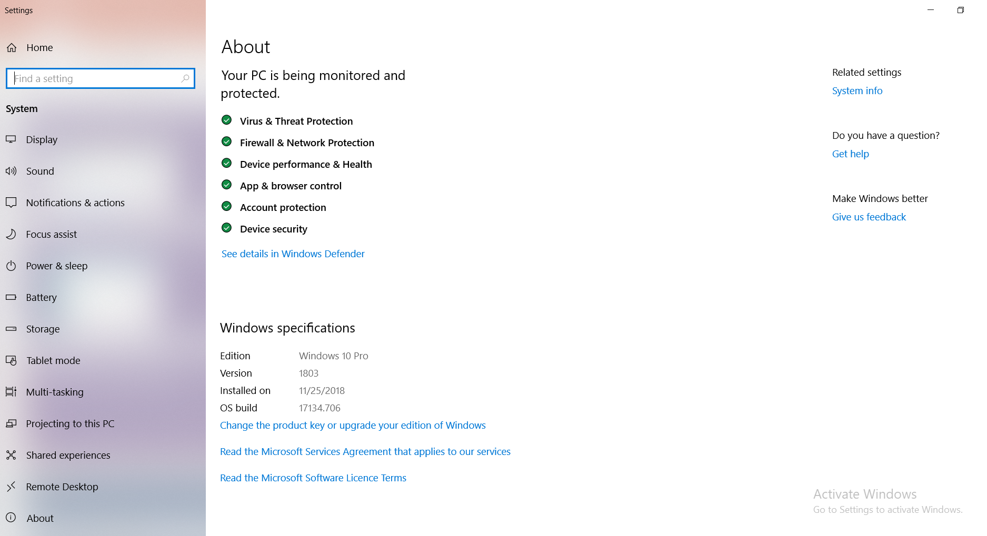
Microsoft 365: Windows 11 Business
Microsoft Windows 10 for Business. Windows 10 is running on desktops, laptops, tablets, mobile phones and IoT (Internet of Things) devices. Windows 10 comes with highly improved security features, a new browser and plenty of features to make work more productive and efficient.

Slide 51
Questions?

Slide 52
Thank You !!!

